Slide 1

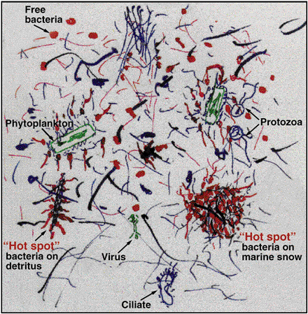

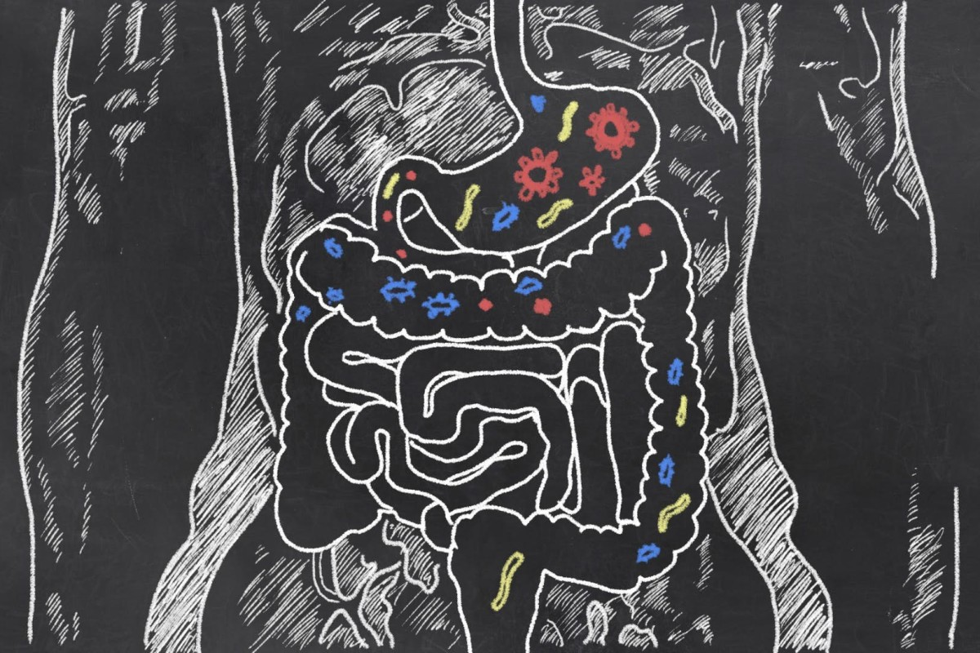
Metagenomics Lesson 9
biovcnet.github.io

Slide 2
Lesson 9 – Bin quality
What & why
Marker genes
CheckM: marker genes in practice
Beyond marker genes
CheckM Demo
https://gtdb.ecogenomic.org/stats
Notes:
Overview of the structure

Slide 3
Recap Lesson 8: What is binning?
Grouping sequenced & assembled DNA sequences from a metagenome into separate draft genomes.
Currently largely restricted to Bacteria & Archaea
Possibly a “transient problem”

Slide 4
Recap lesson 8: binning by differential abundance
data from Speth et al 2015

Slide 5
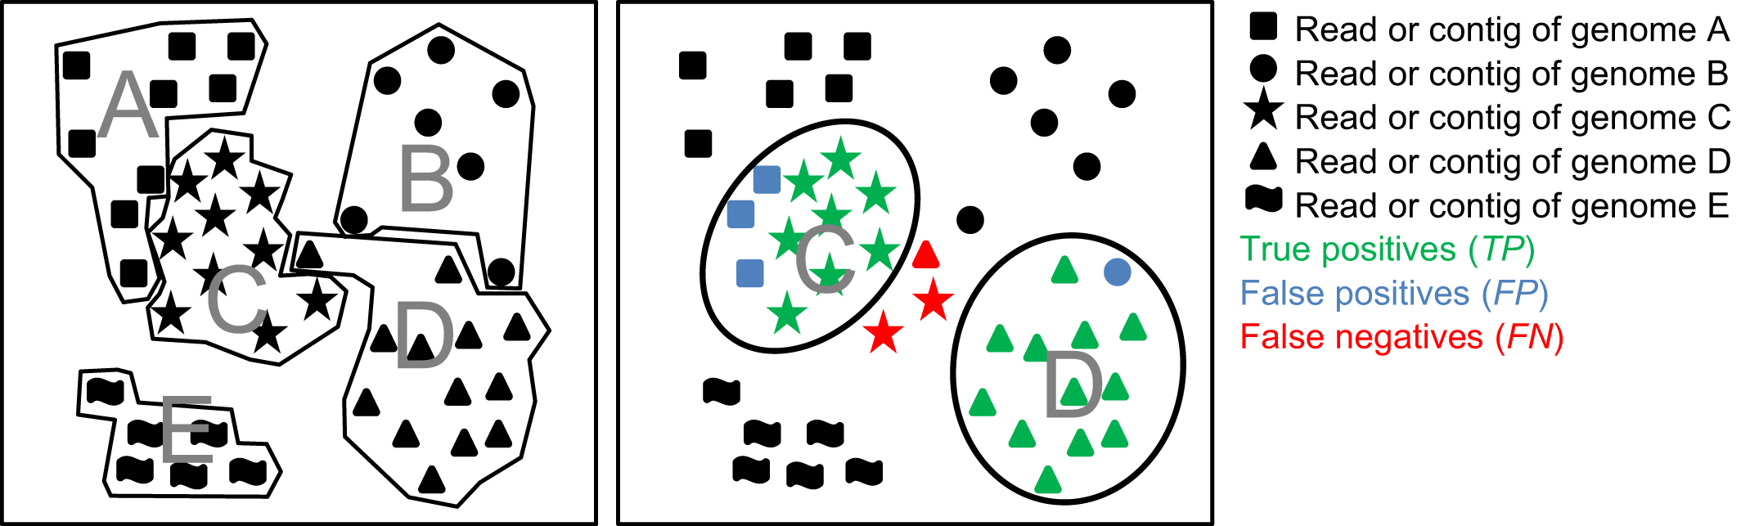
Recap lesson 8: Possible errors in binning
Meyer et al 2018

Slide 6
Consequences of poor quality data
Database rot
Hinders comparative & pan-genomics analysis
Erroneous taxonomic affiliation of proteins
Speth et al ongoing work

Slide 7

Assessing bin quality is
SUPER important

Slide 8
Early days of bin quality assessment
Dupont et al. 2012
Using the Comprehensive Microbial Resource as a database, 107 hidden Markov models (HMMs) that hit only one gene in greater than 95% of bacterial genomes were identified. […] These HMMs were then used to search the SAR86 genomes, and the percentage of the total found was extrapolated for the entire genome.
Albertsen 2013: Currently, there is no best practice for validation of population genome assemblies from metagenomic data in terms of completeness and potential contamination with other species.
Hess et al. 2011
To estimate the completeness of the largest potential microbial draft genomes identified through this approach, we first determined the most likely phylogenetic order from which each of these bins was derived. For each of these orders, we used all available sequenced reference genomes to identify a minimal set of core genes that are present in all members of this order.
To address the possibility that the completeness of individual draft genomes was overestimated as a result of binning of scaffolds derived from multiple organisms, we further validated their authenticity by copy number analysis of genes that were present only in single copy in all reference genomes of the respective phylogenetic order.

Slide 9
Example of marker gene presence/absence
Presence (green) Absence (grey)
Redundancy (red)
Caveats:
- Not all genes present in all phyla
- Redundancy =/= contamination
Speth et al. 2016

Slide 10
Quality assessment: CheckM (Parks et al 2015)
Overview:

Slide 11
Quality assessment: CheckM (Parks et al 2015)
CheckM on isolate genomes

Slide 12
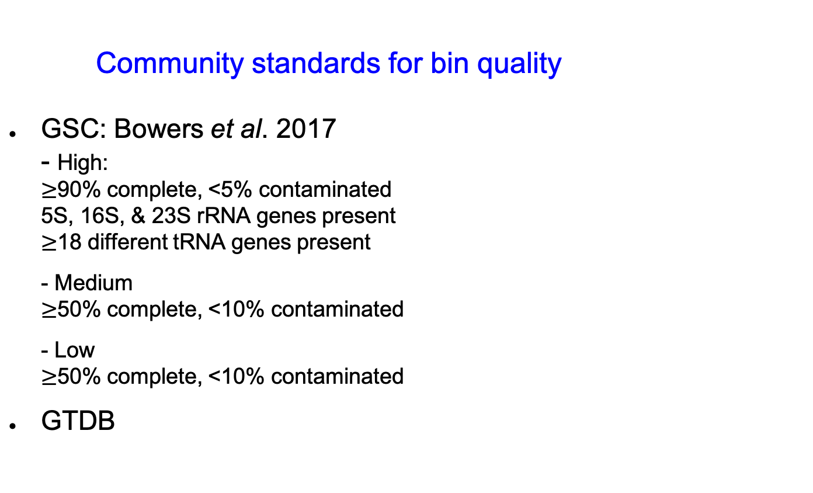
Community standards for bin quality
GSC: Bowers et al. 2017 - High: $≥$90% complete, <5% contaminated 5S, 16S, & 23S rRNA genes present $≥$18 different tRNA genes present - Medium $≥$50% complete, <10% contaminated - Low $≥$50% complete, <10% contaminated
GTDB
https://gtdb.ecogenomic.org/stats

Slide 13
Limitations of marker genes
Marker genes are not homogenously distributed
There’s always exceptions to “universal” or “single copy”
Marker genes are by definition part of the core genome, so completeness estimates miss any pan-genome content
CheckM contains some tools to evaluate bins beyond marker genes

Slide 14
Beyond marker genes

Slide 15
Beyond marker genes
Albertsen et al. 2013

Slide 16
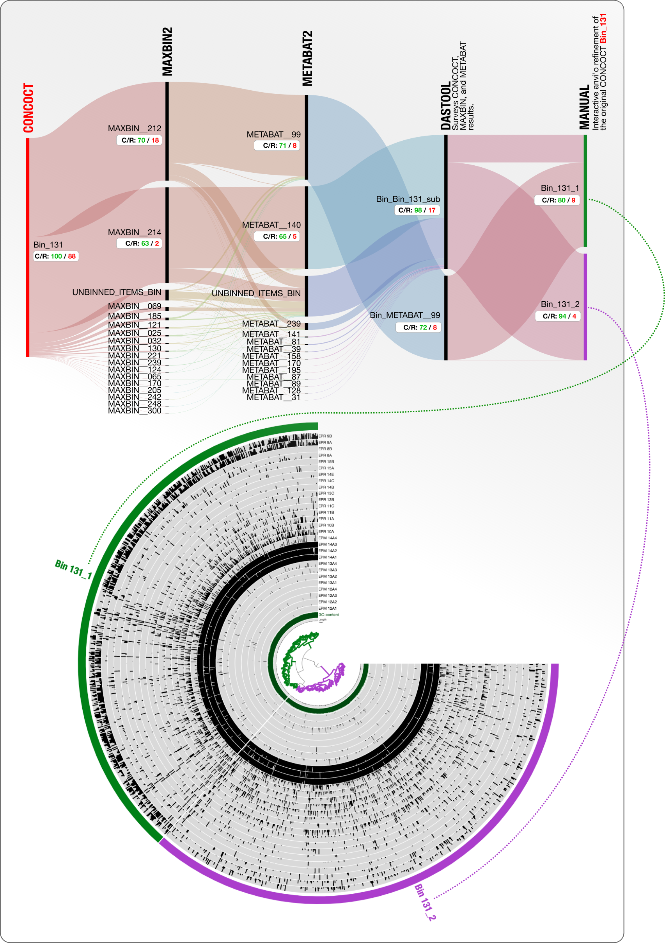
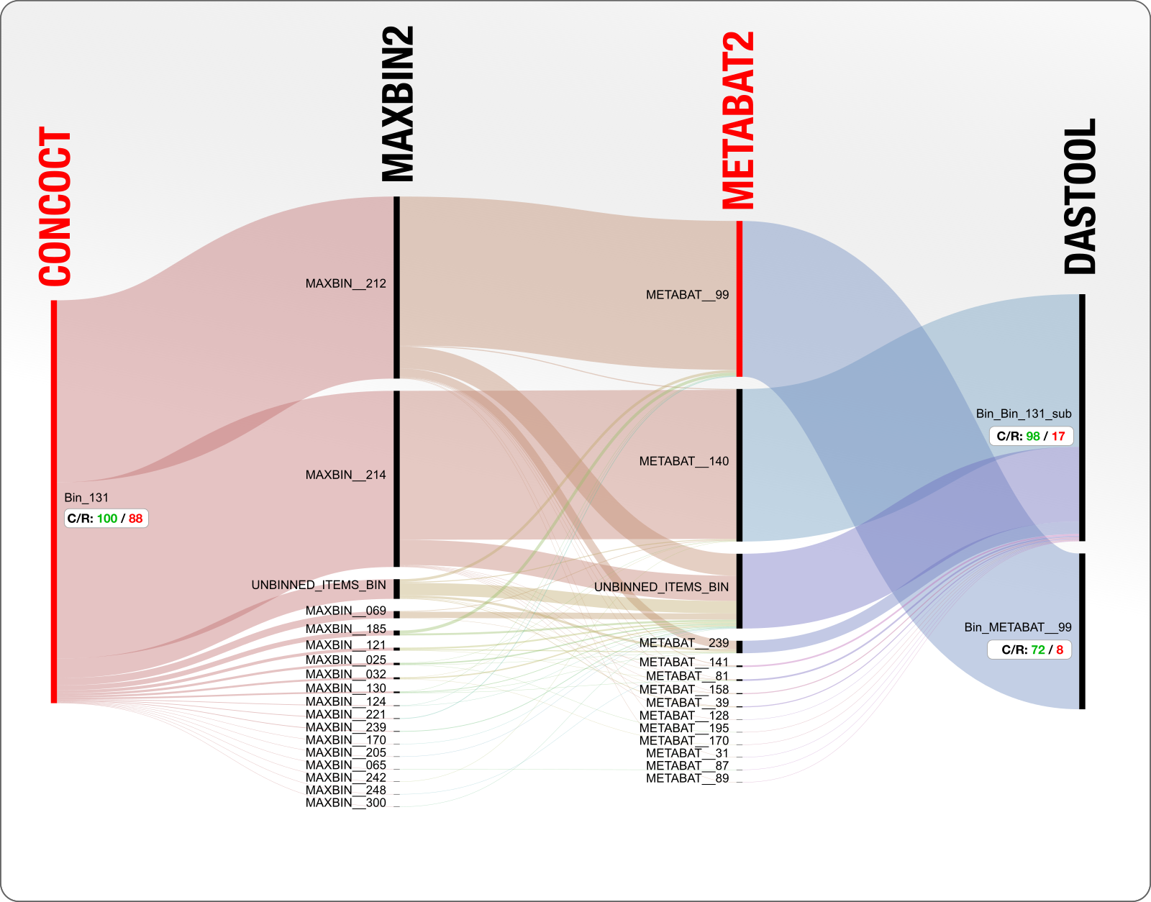
Beyond marker genes
http://merenlab.org/2020/01/02/visualizing-metagenomic-bins/

Slide 17
Beyond marker genes
A little exercise
providing no answers
but hopefully makes you think

Slide 18
Beyond marker genes
Speth et al ongoing work

Slide 19
Beyond marker genes
Speth et al ongoing work

Slide 20
Beyond marker genes
Speth et al ongoing work

Slide 21
Beyond marker genes
Speth et al ongoing work

Slide 22
Beyond marker genes
Speth et al ongoing work

Slide 23
Beyond marker genes
We progressively dropped the number of splits in the bin from 347 to 292 (16% reduction), and the number of bases from 3.75Mb to 3.49Mb (7% reduction, ~250 genes) without changing completeness or contamination
We then, in a giant step, dropped the number of splits from 292 to 190 (35% reduction), and the number of bases from 3.49Mb to 2.81Mb (19% reduction, ~700 genes) and only changed lowered completeness 1.4%.
The difference between the start and finish is 45% of the splits, and 25% of the bases, corresponding to 1000 genes…
What is the right answer here?

Slide 24
Take home messages
Genome bins/MAGs/SAGs live in databases long after publication and will be used in comparative studies.
It is our responsibility to the community to curate the data we submit to databases as well as we reasonably can.
Available tools are great, but there is no magic bullet for bin quality assessment.

Slide 25
Questions?
Next up: hands-on CheckM tutorial https://github.com/biovcnet/bvcn-binder-checkm

